Slide 2
IADI Annual Conference Updated Core Principles to strengthen the Financial Stability Architecture The EU regulatory framework: DGS funding and mandate
Giuseppe Boccuzzi
FITD Director General
22 October 2014

Slide 3
Agenda
The EU regulatory framework: an overview
Core principles and EU directives
DGS funding
DGS mandate
Financing resolution

Slide 4
The EU regulatory framework and the financial crisis: a new approach for managing banking crises
From minimum harmonisation to a wider convergence
Financial crisis
Directive 94/19/CE on DGS
Directive 2014/49/UE on DGS
Directive 2001/24/CE on the reorganisation and winding up of credit institutions
Directive 2014/59/UE on bank recovery and resolution

Slide 5
The final step: Banking Union
A new institutional set-up
Banking Union
Single Supervisory Mechanism SSM
Single Resolution Mechanism SRM
Single DGS
ESM
(European Stability Mechanism) direct recapitalization of troubled banks after 4 Nov 2014
Single
Rulebook
Harmonised network of DGSs

Slide 6
Banking Union: the Single Rule book
A comprehensive set of common rules
SSM Regulation
Framework Regulation
Supervisory
Manual
CRR e CRD IV (Basel 3)
DGSD
BRRD SRM Regulation
……
ITS & RTS EBA
EU Commission delegated acts

Slide 7
Deposit guarantee in the new framework: key questions
The objectives of a DGS are to enhance confidence and contribute to financial stability.
DGSs are essential components of the financial safety net.
Why?
1
Who?
2
Banks private investors and the banking system.
Insolvency or before insolvency? It depends on the DGs mandate: from a pure pay-box to a risk minimiser
When?
3
How?
4
The solution of a bank crisis requires financial resources in different forms: capital, guarantees, financial support, depositors’ pay-out.
Global responses
EU responses
FSB
BCBS
EC
EBA
ECB
NCA

Slide 8
Core Principles and the EU regulatory framework
Principles and guidance addressed to DGS and policy makers
Broader in scope and applicable at a global level (IMF FSAP)
CPs
«should» document
EU Directives
Prescriptive rules addressed to EU member States, the DGSs and their member banks, to be transposed into national legislation
«shall» document

Slide 9
DGS sources and use of funds in the Core Principles (CP9) and DGSD
… readily available funds and all funding mechanisms necessary to ensure prompt reimbursement of depositors’ claims, including assured liquidity funding arrangements.
DGSD
Ex-ante
Fund target size
ex-ante contributions - target of at least 0.8% of total covered deposits in 10 years
extraordinary contributions - ex-post (up to 0.5% of total covered deposits per year)
Funding agreements with the Central bank, the Government and market borrowing
Emerging funding
arrangements
Alternative funding arrangements (short-term), e.g. market and central bank loans
Substantially equivalent
Voluntary mutual borrowing among EU DGS
contributions proportional to the risk of the members and taking into due account the risk profiles of the various business models and balance sheet and risk indicators, such as capital adequacy, asset quality and liquidity
Differential premiums
EBA Guidelines

Slide 10
DGS mandate in CP2 and in Directive 2014/49/EU (Art. 10)
Pay-box
Paragraph 1 → repay depositors;
Paragraph 2 → finance the resolution
Paragraph 3 → for alternative measures to prevent the failure;
Paragraph 6 → to finance measures to preserve the access of depositors to covered deposits, including transfer of assets and liabilities and deposit book transfer, in the context of national insolvency proceedings, provided that the costs borne by the DGS do not exceed the net amount for compensating covered depositors.
Pay-box plus
Loss minimiser
Risk minimiser
DGSD - art. 11
Use of funds

Slide 11
Financing resolution in the EU framework
Resolution procedure
Private resources
Mandatory residual contribution
Bail-in
Resolution funds
DGSs
Art. 11 (2) DGSD: mandatory DGS contribution in resolution
Condition: bail-in at least equal to 8% of total liabilities
Limit: up to 5% of total liabilities
Art. 109 BRRD: use of the DGS in the context of resolution → cash contribution as a loss absorber taking the place of covered depositors
Art. 108 BRRD: depositor preference

Slide 12
DGS role in financing resolution: conditions (1/3)
CP9
DGSD & BRRD
Where the deposit insurer is not the resolution authority, it has the option, within its legal framework, to authorise the use of its funds for resolution of member institutions other than liquidation.
In such situations the following conditions are met:
(a) the deposit insurer is informed and involved in the resolution decision-making process;
(b) the use of the deposit insurer’s funds is transparent and documented and is clearly and formally specified;
Mandatory use of DGS funds in resolution:
The financial means of DGS shall be used in order to finance the resolution of credit institutions in accordance with article 109 of BRRD. The Resolution Authority shall determine, after consulting the DGS, the amount by which the DGS is liable (art. 11 (2) DGSD).
Recital 51: Competent authorities, designated authorities, resolution authorities, relevant administrative authorities and DGSs should cooperate with each other. They should cooperate from an early stage in the preparation and implementation of the resolution measures(…).
Art. 4 (10): Member States shall ensure that the DGSs are informed as soon as possible in the event that (…) a bank and the intervention of the DGS becomes likely.

Slide 13
DGS role in financing resolution: conditions (2/3)
CP9
DGSD & BRRD
(c) where a bank is resolved through a resolution process other than liquidation, the resolution results in a viable, solvent and restructured bank, which limits the exposure of the deposit insurer to contribute additional funding in respect of the same obligation;
Art. 109 (1) BRRD: (…) the DGS to which the institution is affiliated is liable for the amount of losses that covered depositors would have suffered, had covered depositors be exposed to losses in the application of resolution tools.
Art. 108 BRRD: depositor preference
The DGS is a loss absorber on behalf of covered depositors (virtual bail-in of the DGS).
Residual contribution to resolution

Slide 14
DGS role in financing resolution: conditions (3/3)
CP9
DGSD & BRRD
(d) contributions are restricted to the costs the deposit insurer would otherwise have incurred in a payout of insured depositors in a liquidation net of expected recoveries;
(e) contributions are not used for the recapitalisation of resolved institutions;
(f) the use of the deposit insurer’s funds is subject to an independent audit and the results reported back to the deposit insurer; and
(g) all resolution actions and decisions using the deposit insurer’s funds are subject to ex-post review.
Art. 109 (1) BRRD: In all cases, the liability of the DGS shall not be greater than the amount of losses that it would have had to bear had the institution been wound up under normal insolvency proceedings (no creditor worse-off).
When the bail-in tool is applied, the DGS shall not be required to make any contribution towards the costs of recapitalising the bank or bridge-bank.
Valuation of difference in treatment as per Art. 74 BRRD.
Art. 75 BRRD: in case the DGS has incurred greater losses than it would have incurred in a winding up under normal insolvency proceedings, the DGS is entitled to the payment of the difference from the resolution financing arrangements.

Slide 15
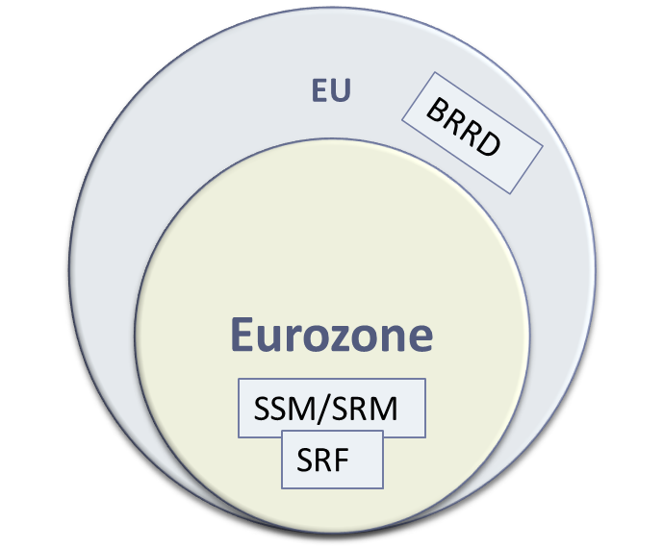
Financing resolution: critical issues
In the design of the EU regulatory framework DGSs are at a national level
DGSD
In the EU member States that are participating in the SSM-SRM, DGS is national and the RF will be the SRF
In the EU member States that are not participating in the SSM-SRM, the DGS and the RF are both national and may be managed by the same institution
EU members in the Banking Union
Two different levels:
EU members not in the Banking Union

Slide 16
Way forward
Should DGSs remain national or shift to a single system?
How should the DGS interact with the centralised resolution authority?
What will the role of the DGS be in the future?
The role of deposit insurers international associations

Slide 17
Thank you for your kind attention

